Slide 1




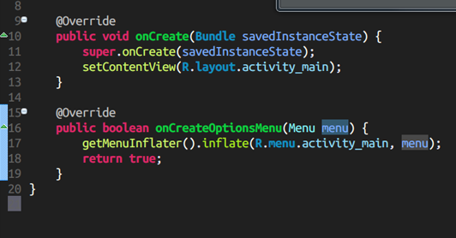
Java Fundamentals
Course Program,
Evaluation, Exams
Java Fundamentals
SoftUni Team
Technical Trainers
Software University
http://softuni.bg

Slide 2




Table of Contents
Course Objectives
Course Program
Trainers Team
Examination
Learning Resources

Slide 3










SoftUni Diamond Partners

Slide 4

SoftUni: Levels, Modules, Schedule
Programming Basics
2 months
6 credits
Programming Fundamentals
36 credits
6 months
Advanced C#
Object-Oriented Programming
High-Quality Code
Java Fundamentals
Teamwork and Personal Skills
Web Front-End
Back-End
36 credits
36 credits
HTML + CSS + WordPress
JavaScript Basics
Advanced JavaScript
Databases
Database Applications
Web Services and Cloud
6 months
JavaScript Applications
JavaScript Frameworks
PHP Web Development
ASP.NET MVC Web Development

Slide 5


Warning: Not for Absolute Beginners
The "Java Fundamentals" course is NOT for absolute beginners
Take the “Programming Basics" course at SoftUni first: https://softuni.bg/courses/programming-basics
The course is for beginners, but with previous coding skills
Requirements
Coding skills – entry level
Computer English – entry level
Logical thinking
coding skills
required!

Slide 6


Java Fundamentals Course
Java Fundamentals
Course Objectives & Program

Slide 7

Course Objectives
The "Java Basics" course:
First steps in Java programming:
Compiler, IDE, variables, control-flow logic, console I/O, loops
Methods, arrays, lists, sets, maps, strings
Develop algorithmic thinking and problems solving skills
Prepare for learning other languages and software technologies
HTML, CSS, JavaScript, PHP, Python, Ruby, …
Databases & SQL, high-quality code
Web development technologies & mobile platforms

Slide 8

Java Fundamentals – Course Topics
Course Introduction. Introduction to Java, JDK and Eclipse
Java Syntax – Data types, Expressions, Condtitionals
Loops (while, do-while, for, foreach) Methods. Basic Exception Handling Using Built-In Java Classes. Defining Own Classes
Arrays, Strings, Lists, Dictionaries, Sets
Java OOP
Java Best Practices
Team work + Labs + Workshops
Practical Exam

Slide 9

The Trainers Team

Slide 10

Trainers Team
Ivan Yonkov
Training Lead & Trainer @ SoftUni
Rated in the top 7% at Stack Overflow
5 years of programming experience mainly with Java and PHP
Solid experience as QA engineer
Top performing student from the Software University (2014)

Slide 11

Trainers Team (1)
Bogomil Dimitrov
Part-time trainer @ SoftUni
Top performing student from the Software University (2014)
Studying IT in NBU

Slide 12
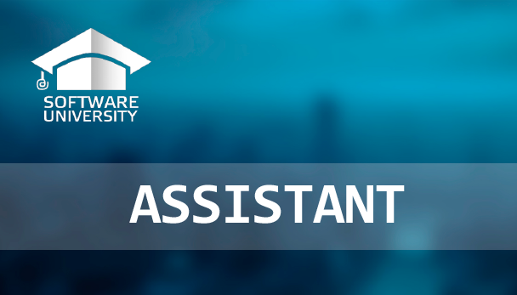
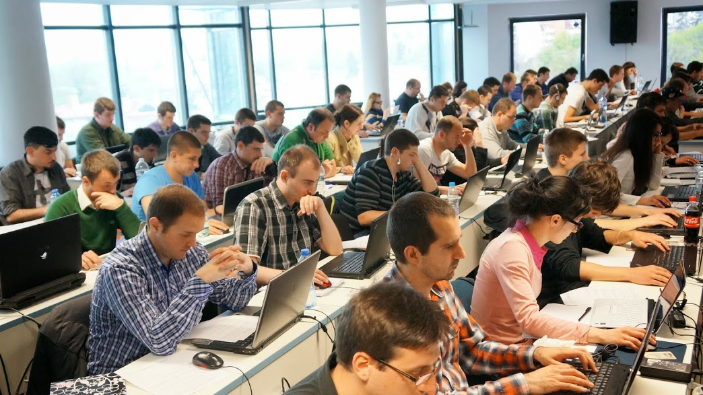
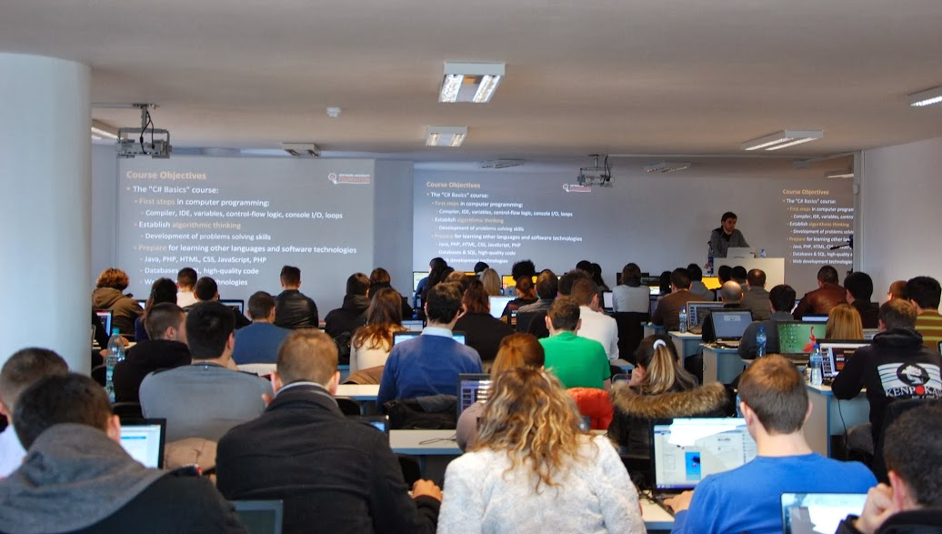
Volunteer Teaching Assistants
15+ volunteer teaching assistants
Scholarship students from SoftUni
Top students from SoftUni

Slide 13

Java Fundamentals: More Details
Duration, Languages, Technologies

Slide 14


Training Duration – Java Fundamentals
Lectures: ~ 30-40 hours (onsite + YouTube videos)
Practical exercises (in class): ~ 20-30 hours
Homework: ~ 30-50 hours
Team project: ~10-20 hours
Exam preparation: ~ 20 hours
Exam: 6 hours
Schedule: March-April 2016
Exam date: 17 April 2016

Slide 15

Why Java?
The Java platform is very popular
Free and open-source software (see OpenJDK)
Runs everywhere, on millions of devices
Supported by big players: Oracle, IBM, Google, SAP
Runs many languages: Java, Python, Ruby, Groovy, Closure, …
The Java language
Modern object-oriented language
7-10 millions Java developers in 2012 (source)

Slide 16



Why English?
Why the slides are in English?
English is the native language of the software engineers
Specific terminology should be in English
Translations are inaccurate and funny
Just learn English!
No excuses

Slide 17



Java Fundamentals
Evaluation Criteria

Slide 18


Scoring System "Java Fundamentals" Course
Exam – 80%
Labs – 10% (added to the exam results)
Homework + evaluation – 5% + 5%
Team work – 10%
Bonuses – up to 10%
Presence in class – 5% (onsite students only)

Slide 19
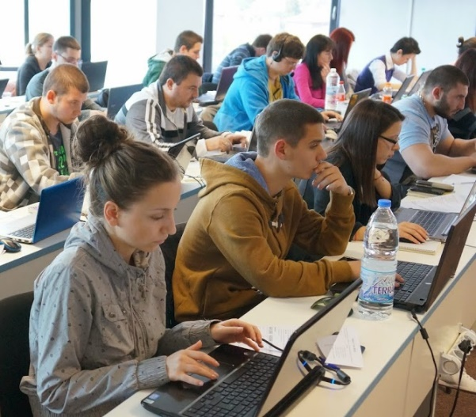

The Java Fundamentals Exam
Practical programming exam
4 practical problems for 6 hours
1 easy, 1 text processing , 1 with loops,
1 with arrays / sets / maps
You should code in Java
Automated judge system with real-time feedback
http://judge.softuni.bg
Solutions are evaluated for correctness only
Code quality is still not measured

Slide 20

Homework Assignments
Doing your homework is very important!
Programming can only be learned through a lot of practice!
You should write code every day!
Each lecture is followed by a few exercises
Try to solve them in class
The rest are your homework
Homework assignments are due in 1 week after each lecture
Submission will be accepted through our web site: softuni.bg

Slide 21

Homework Peer Reviews
Give feedback to a few random homework submissions
Students submit homework anonymously
Please exclude your name from the submissions!
For each homework submitted
Students evaluate 3 random homeworks
From the same topic, after the deadline
Give written feedback, at least 200 characters
Low-quality feedback → report for punishment
Everyone will get feedback for their homework

Slide 22









Resources
What We Need Additionally?

Slide 23

Course Web Site & Forums
The Java Basics official web site:
Register for the "Software University Forum":
Discuss the course exercises with your colleagues
Find solutions for all course exercises
Share source code / discuss ideas / help each other
https://softuni.bg/courses/java-fundamentals
https://softuni.bg/forum

Slide 24



The Java Programming Slides and Videos
All lecture slides, videos, homework assignments, projects and other resources are open content, available for free
Visit the course web site to access the course resources

Slide 25


Free Java Fundamentals Textbook
The official textbook for the Java Fundamentals course
The official Java Tutorial from Oracle:
http://docs.oracle.com/javase/tutorial/java/
“Fundamentals of Computer Programming with Java”, by Svetlin Nakov & Co., 2009, ISBN 9789544000554
Bulgarian version only available (as PDF, ePub, …)
Freely downloadable from: www.introprogramming.info
Read chapters 1…13 (up to Strings), optionally all others

Slide 26
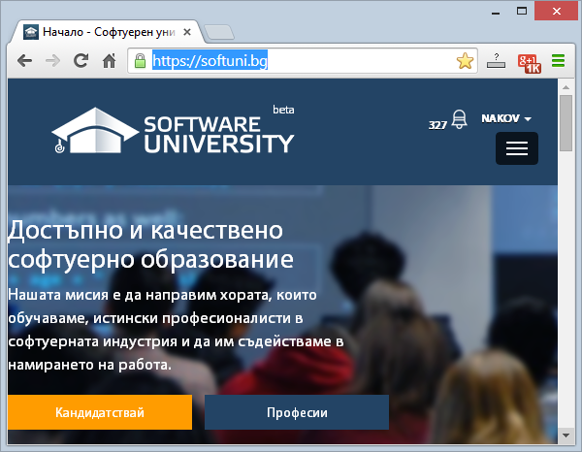
Software University Learning System (SULS)
Software University Learning System (SULS)
www.softuni.bg
Important resource for students
Homework submissions
Homework check-up
Exams and results
Reports about your progress
…

Slide 27
Required Software
Recommended software for the Java Fundamentals course:
You favorite operating system
JDK 8 (Java SE Development Kit 8)
Install JDK (not JRE!) – https://jdk8.java.net/download.html
IntelliJ IDEA – http://www.jetbrains.com/idea/download/
Any other Java IDE may also be used: Eclipse, Netbeans, …

Slide 28

Summary
The "Java Basics" course provides
The first steps in Java programming
Training program
Java platform, using Eclipse, variables, control-flow logic, loops, advanced topics
Practical exams
Automated judge system + score system
Learning resources
Lectures, videos, software, books, forum
Java Basics

Slide 29
Java Fundamentals – Course Introduction
https://softuni.bg/courses/java-fundamentals

Slide 30
License
This course (slides, examples, demos, videos, homework, etc.) is licensed under the "Creative Commons Attribution-NonCommercial-ShareAlike 4.0 International" license
Attribution: this work may contain portions from
"Fundamentals of Computer Programming with C#" book by Svetlin Nakov & Co. under CC-BY-SA license
"C# Part I" course by Telerik Academy under CC-BY-NC-SA license

Slide 31





Free Trainings @ Software University
Software University Foundation – softuni.org
Software University – High-Quality Education, Profession and Job for Software Developers
softuni.bg
Software University @ Facebook
facebook.com/SoftwareUniversity
Software University @ YouTube
youtube.com/SoftwareUniversity
Software University Forums – forum.softuni.bg

